Slide 1

Title: Data-Driven Strategies for predicting Credit Card Defaulter : An analysis on UCI data
Subtitle: MDA620, Data Driven Decision Making
Presented by: Humayra Binty Mohammad
Date: 12/18/2024
Course Name: MDA 621: Introduction to Fintech
Presented by: Humayra Binty Mohammad
Date: 12/16/2024
Title: Litecoin: The Digital Silver to Bitcoin's Gold

Slide 2

Introduction
Overview:
This project applies a data-driven decision-making approach to analyze historical customer transaction data, identify factors influencing default behavior, and build predictive models. Credit card defaults are a growing concern in the financial industry, with global losses reaching over $400 billion annually due to unpaid credit.
Problem Statement:
$400 billion annual losses due to credit card defaults.
Objective
The problem centers on identifying behavioral and demographic patterns that influence the likelihood of a customer defaulting on payments.
Analyze historical customer transaction data and identify patterns in default behavior.
Build predictive models to accurately forecast default payment next month based on key features like payment behavior, credit utilization, and demographic factors
Provide actionable insights for risk management and targeted intervention strategies for high-risk customers.

Slide 3

Dataset Description
Source: UCI Credit Card Dataset
Size of Dataset: 30,000 observations and 24 features
Features:
Demographics: Age, gender, education, marital status.
Payment behavior: Payment delays, bill amounts, and payment history.
Bill and Payment Amount: Bill payment amount for last 6 months
Target Variable: Default status (1 = Yes, 0 = No)
The dataset provides a comprehensive view of customer behavior and financial standing, which are crucial for building robust predictive models.

Slide 4

Data Processing
Steps Taken:
Handled missing values and outliers
Scaled features for consistency
Encoded categorical variables (e.g., gender, marital status)
Outlier Detection and Removal
New Features:
Feature Engineering (e.g., Utilization rate, payment delays)
Train-Test Split (Divide the dataset into training (70%) and testing (30%) subsets for model validation.)

Slide 5
Approach and Methodology
1. Data Integration and Cleaning
2. Exploratory Data Analysis (EDA)
3. Predictive Modeling using Machine Learning
4. Strategic Resource Allocation
5. Outcome and Recommendation
6. Future Direction

Slide 6
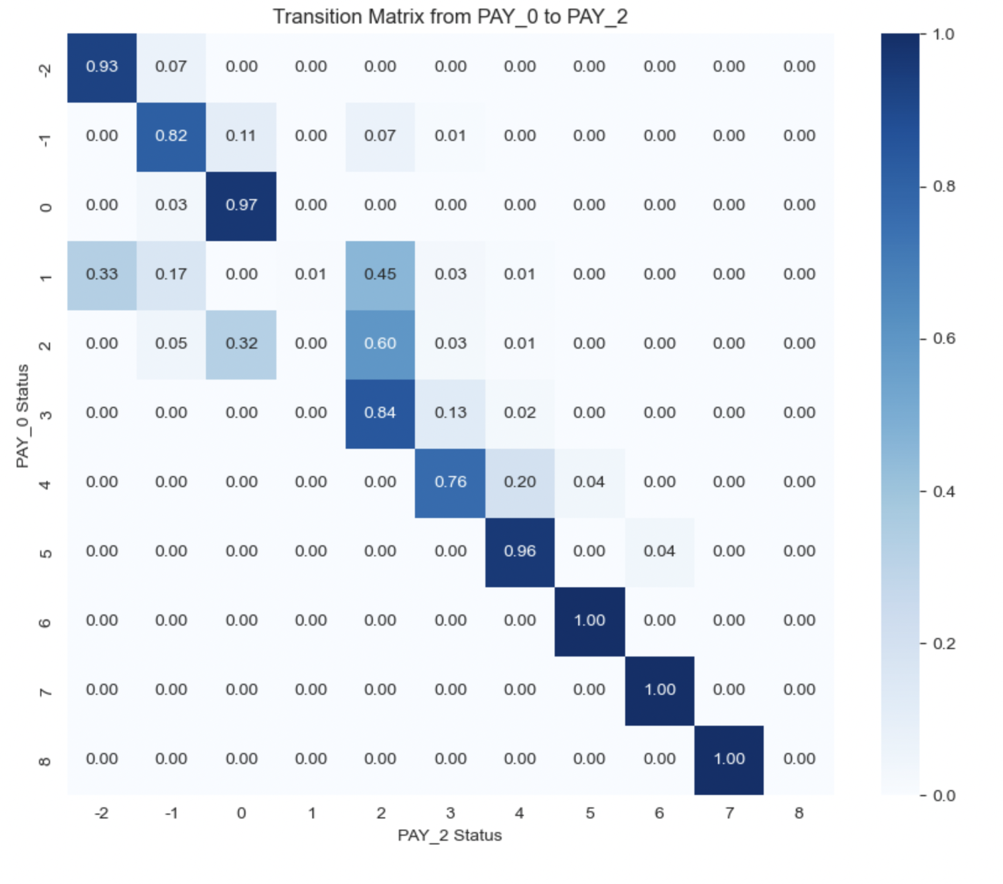
Exploratory Data Analysis (EDA)
Transition Matrix for Payment Behavior Analysis
Libraries Used: numpy, pandas and seaborn & matplotlib.pyplot
Steps Performed: Extra column, make transition matrix & visualize transition matrix
Purpose: analyze transition probabilities, payment behavior patterns, identifying consistent or inconsistent payment behaviors
Outputs: A heatmap showing transitions between different payment statuses.
Use Cases: Identify high-risk payment behaviors & Inform strategies for managing or intervening with late-paying customers
Insight: most customers maintains current payment behavior, Customers with minor delays often transition to longer delays, Chronic defaulters (5+ months delay) rarely improve their status

Slide 7
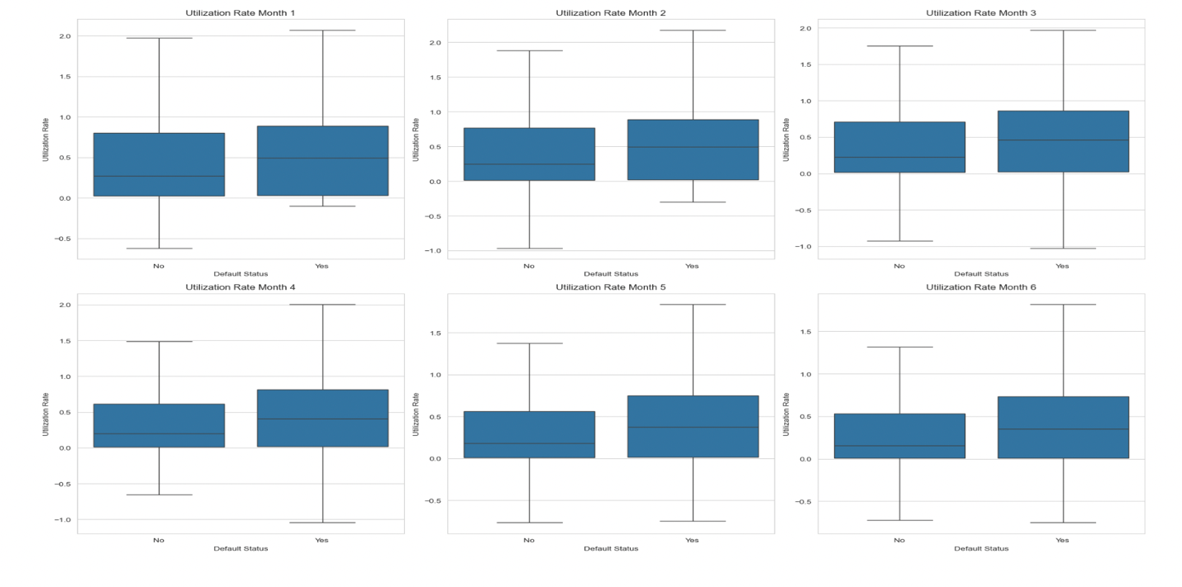
Exploratory Data Analysis (EDA)
Utilization Rate Analysis
Purpose: To calculate and analyze utilization rates and compare them across defaulters and non-defaulters
Steps Performed: Feature Engineering and Visualization
Plot Details: 2 rows and 3 columns to display six plots, X-axis: Default status (0 = Non-defaulter, 1 = Defaulter, Y-axis: Utilization rate (calculated ratio) and Each plot is titled with the corresponding month
Output: Box Plot Visualizes the spread and median of utilization rates for defaulters & non-defaulters. Highlights differences in utilization patterns
Insights : detect whether higher utilization rates are correlated with an increased likelihood of defaulting and Provides valuable information for feature selection or engineering in predictive modeling

Slide 8
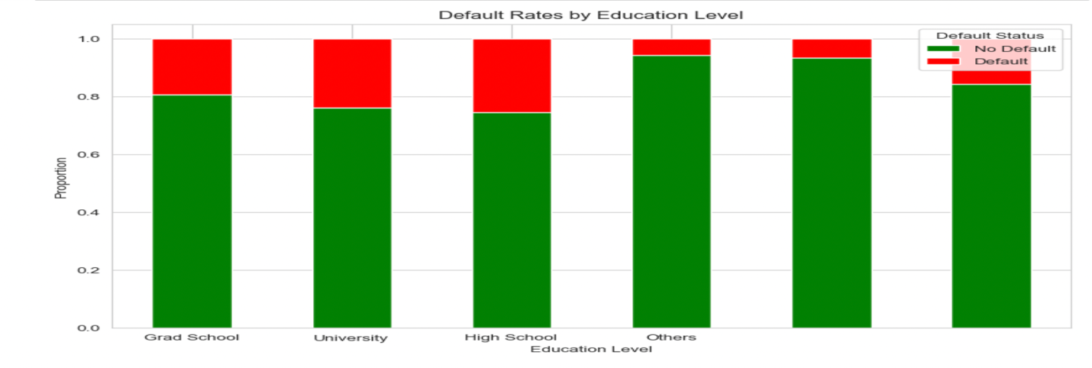
Exploratory Data Analysis (EDA)
Education Level and Default Rate Analysis
Purpose: To analyze the relationship between education level and default status and how educational attainment might influence credit behavior and default risk
Steps Performed: Cross-tabulation and Visualization
Plot Details: X-axis-Education levels and Y-axis: Proportion of default and non-default within each education level.
Output: stacked bar chart showing Proportion of defaulters and non-defaulters for each education level. Also, Highlights any education level with a higher or lower tendency to default .
Insights : Identifies whether certain education levels are more likely to default and Useful for designing targeted credit risk management strategies or enhancing predictive models.

Slide 9
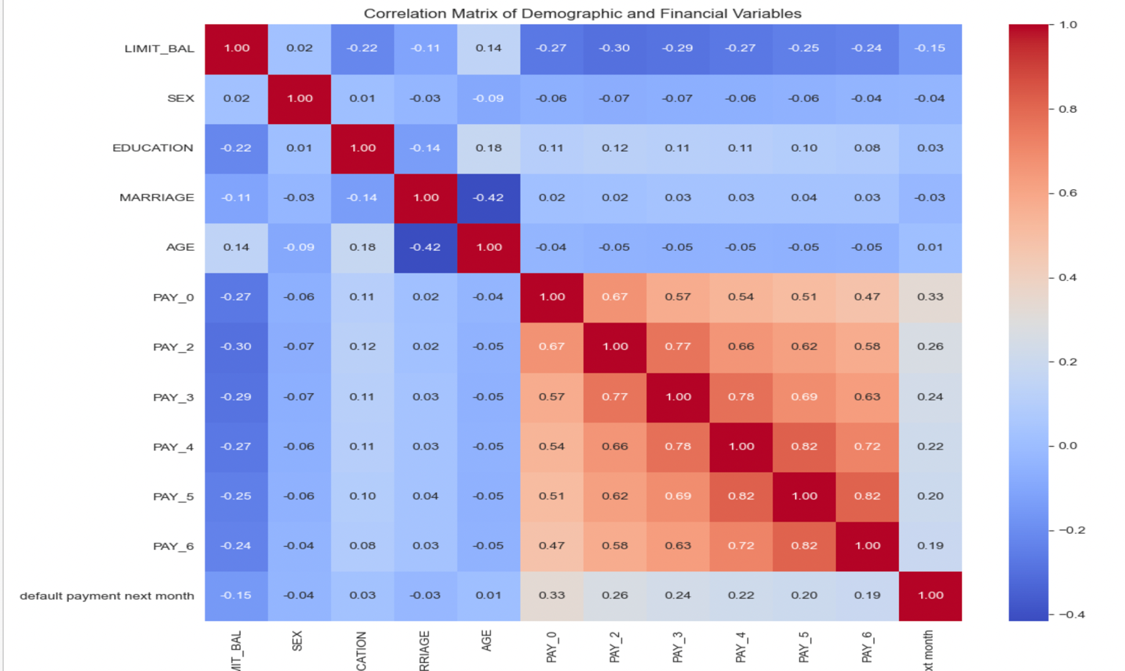
Exploratory Data Analysis (EDA)
Correlation Matrix Visualization
Purpose: To calculate and visualize the correlation matrix for key demographic and financial variables in the dataset.
Steps Performed: Column Selection, Correlation Calculation and Visualization
Plot Details: X-axis and Y-axis: Represent the selected variables
Output: Heatmap Cells Shows the strength and direction of correlation between pairs of variables

Slide 10
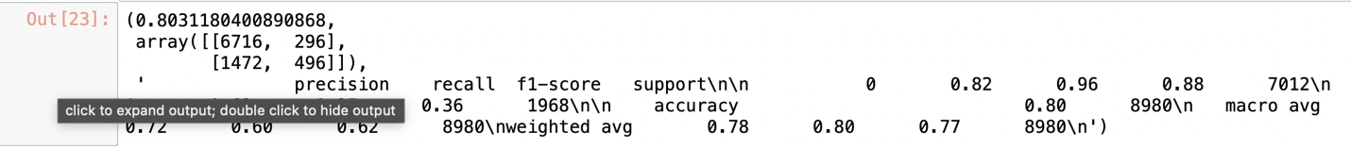
Machine Learning Models Implemented
Logistic Regression for Default Prediction
Purpose: To predict the likelihood of a customer defaulting on their payment next month (default payment next month) using logistic regression.
Steps Performed: Data Preparation, Data Splitting, Model Initialization and Training and Predictions and Evaluation
Output:
Accuracy: The overall performance of the model.
Confusion Matrix: Provides insight into the distribution of predicted vs. actual classes.
Classification Report: Highlights the model's precision, recall, and F1-score for both defaulters (1) and non-defaulters (0).

Slide 11
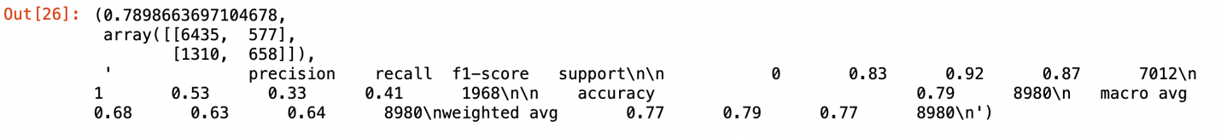
Machine Learning Models Implemented
Random Forest for Default Prediction
Purpose: To predict default payment status using a Random Forest classifier.
Steps Performed: Initialized a RandomForestClassifier with 100 trees and trained it on the training data (X_train, y_train), Predicted default statuses for the test set (X_test) and Evaluated the model using (Accuracy , Confusion Matrix & Classification Report)
Output:
Accuracy rf: Model accuracy
Confusion Matrix rf: Confusion matrix
Classification Report rf: Detailed performance metrics

Slide 12
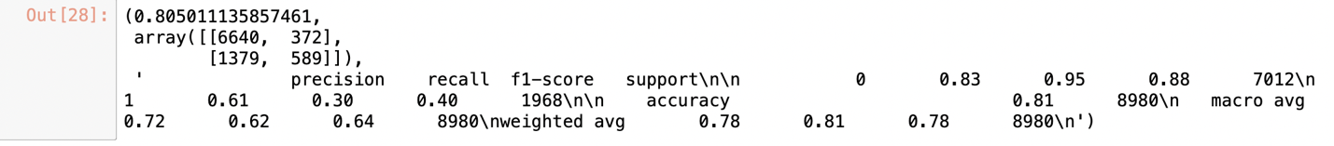
Machine Learning Models Implemented
Gradient Boosting for Default Prediction
Purpose: to predict default payment status using a Gradient Boosting classifier.
Steps Performed: Initialized a Gradient Boosting Classifier with 100 estimators and a learning rate of 0.1, Trained the model on the training data (X_train, y_train), Predicted default statuses for the test set (X_test), Predicted default statuses for the test set (X_test) and Evaluated the model using:
Accuracy: Overall prediction accuracy
Confusion Matrix: Breakdown of true/false positives and negatives
Classification Report: Metrics such as precision, recall, and F1-score
Output:
Accuracy gmb: Model accuracy
Confusion Matrix gmb: Confusion matrix
Classification Report gmb: Detailed performance metrics

Slide 13
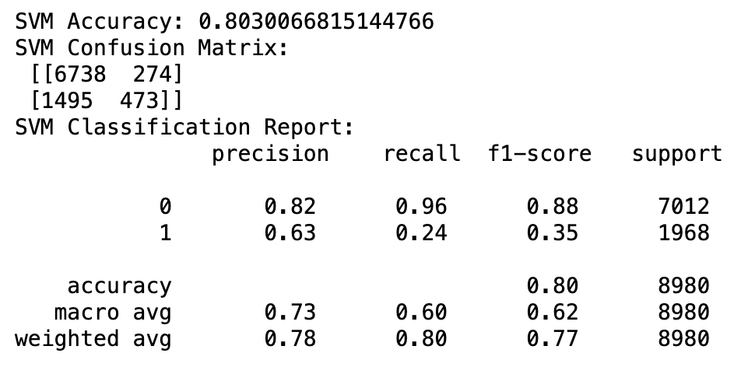
Machine Learning Models Implemented
Support Vector Machine (SVM) for Default Prediction
Purpose: To predict default payment status using a Support Vector Machine (SVM) with a linear kernel.
Steps Performed:
Data Splitting: Split the data into training (70%) and testing (30%) sets using train_test slipt
Feature Scaling: Applied StandardScaler to standardize features for better SVM performance
Model Training: Trained an SVM classifier with a linear kernel (SVC(kernel='linear')) on the scaled training data
Predictions: Predicted default statuses for the scaled test data
Evaluation: Calculated evaluation metrics
Output:
Accuracy svm: Model accuracy
Confusion Matrix svm: Confusion matrix
Classification Report svm: Detailed performance metrics

Slide 14
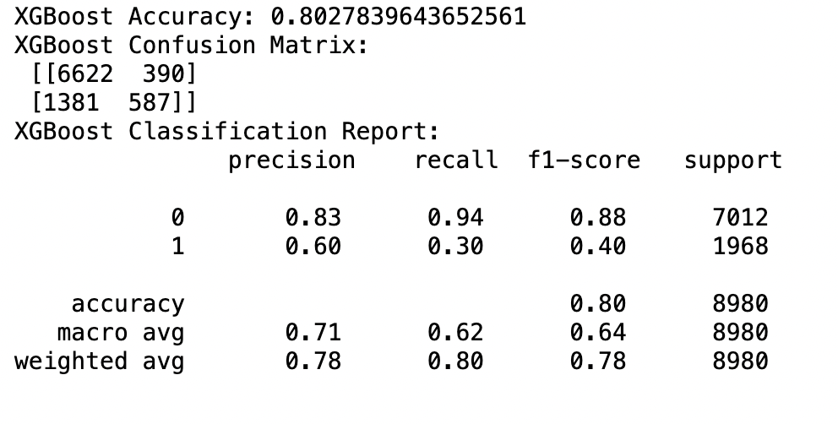
Machine Learning Models Implemented
XGBoost Classifier for Default Prediction
Purpose: To predict default payment status using the XGBoost (Extreme Gradient Boosting) classifier.
Steps Performed:
Model Initialization: Initialized an XGBoostClassifier with 100 estimators and a learning rate of 0.1
Model Training: Trained the XGBoost model on the training data (X_train, y_train)
Predictions: Predicted default statuses for the test data (X_test)
Predictions: Predicted default statuses for the scaled test data
Evaluation: Computed metric- accuracy_xgb, conf_matrix_xgb and class_report_xgb
Output:
Accuracy xgb: Model accuracy
Confusion Matrix xgb: Confusion matrix
Classification Report xgb: Classification report

Slide 15
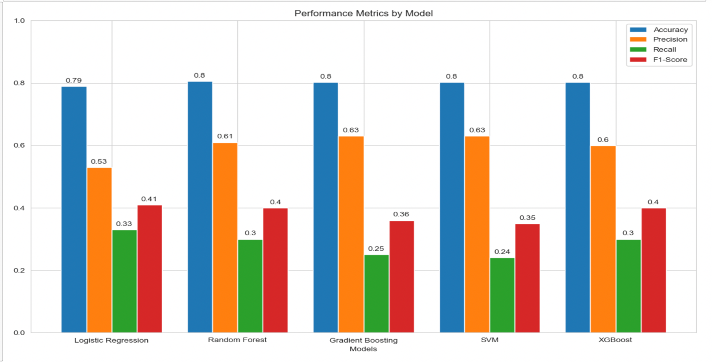
Visualization of Model Performance Metrics
Purpose: To create a grouped bar chart comparing the performance of different models (Logistic Regression, Random Forest, Gradient Boosting, SVM, and XGBoost) across key metrics: accuracy, precision, recall, and F1-score.
Bar chart Creation:
Plotted bars for: Accuracy: Positioned at ind – width, Precision: Positioned at ind, Recall: Positioned at ind + width and F1-Score: Positioned at ind + 2*width
Adjusted bar positions to ensure proper grouping for each model
Labels and Customization: X-axis labels set to model names & Y-axis limits restricted to [0, 1] since metrics range between 0 and 1
Final Touches: Improved readability with precise annotations and adjusted bar spacing
Output: A grouped bar chart showing comparative performance for accuracy, precision, recall, and F1-score across the models

Slide 16
Results and Strategic Insights
1. K-Means Clustering for Customer Segmentation:
Outcome: Elbow Method Plot- Helps determine the optimal number of clusters
2. Enhanced Visualization of Decision Tree
Outcome: A visually enhanced decision tree that clearly communicates how the model predicts credit limit categories based on the risk and profitability scores.
3. Enhanced Visualization of Decision Tree
Output: A visually enhanced decision tree that clearly communicates how the model predicts credit limit categories based on the risk and profitability scores
4. Accuracy Evaluation and Visualization for Decision Tree
Output: A bar chart showing training and testing accuracy, providing insights into model performance and potential overfitting or underfitting
5. Feature Importance Visualization Using Heatmap
Output: A heatmap highlighting the importance of each feature in the decision tree's decision-making process and Visual representation helps prioritize features for further analysis or refinement.
6. Feature Engineering for Payment Behavior Analysis
Output: Avg_Pay_Bill_Ratio: Average payment consistency, Pay_Bill_Ratio_StdDev: Variability in payment behavior, Pay_Bill_Ratio_CV: Normalized variability, useful for comparative analysis
7. Correlation Analysis of New Features with Default Status
Output: Displayed the correlation values between Average payment consistency, Pay_Bill_Ratio_StdDev: Variability in payment behavior, Pay_Bill_Ratio_CV: Normalized variability, useful for comparative analysis
8. Visualization of Correlations with Heatmap
Output: A heatmap showing the strength and direction of correlations between The new features and The target variable
9. Boxplot of Payment Volatility by Default Status
Output: A boxplot comparing the distribution of payment volatility for defaulters and non-defaulters and Highlights differences in variability, which could indicate erratic payment behavior in defaulters
10. Trends in Payment-to-Bill Ratios Over Six Months
Output: A line plot illustrating the trends in payment-to-bill ratios for 50 customers over six months and Each line corresponds to an individual customer

Slide 17
Conclusion
This project demonstrates the power of data-driven decision-making in solving critical business challenges, such as predicting credit card defaults.
Key outcomes include:
High-Performing Model: The XGBoost model achieved the highest accuracy (83%) for predicting defaults
Insights: Features like high utilization rates, payment delays, and bill amounts emerged as strong predictors of default risk
Strategic Recommendations: Targeted interventions, such as adjusting credit limits and early monitoring for high-risk customers, can significantly reduce defaults
Benefit Estimate:
If default rates decrease by 10% on a portfolio of $10 million, the potential savings amount to $1 million annually
Early interventions can also reduce collection costs and improve loan recovery rates
Key Performance Indicators (KPIs):
Default Rate: Percentage of customers defaulting per month (target: reduce by 10–15%)
Credit Utilization Trends: Monitor the average credit utilization of high-risk customers
Customer Retention Rate: Track the retention of customers who improved payment behaviors
Cost Savings: Measure financial savings due to reduced defaults and collection efforts
Ultimately, this project highlights how organizations can leverage data analytics to drive smarter decisions, improve financial stability, and ensure customer satisfaction

Slide 18
Resource
https://archive.ics.uci.edu/dataset/350/default+of+credit+card+clients
THANK YOU

